Slide 1

RESEARCH/INVESTIGATION QUESTIONS

Slide 2
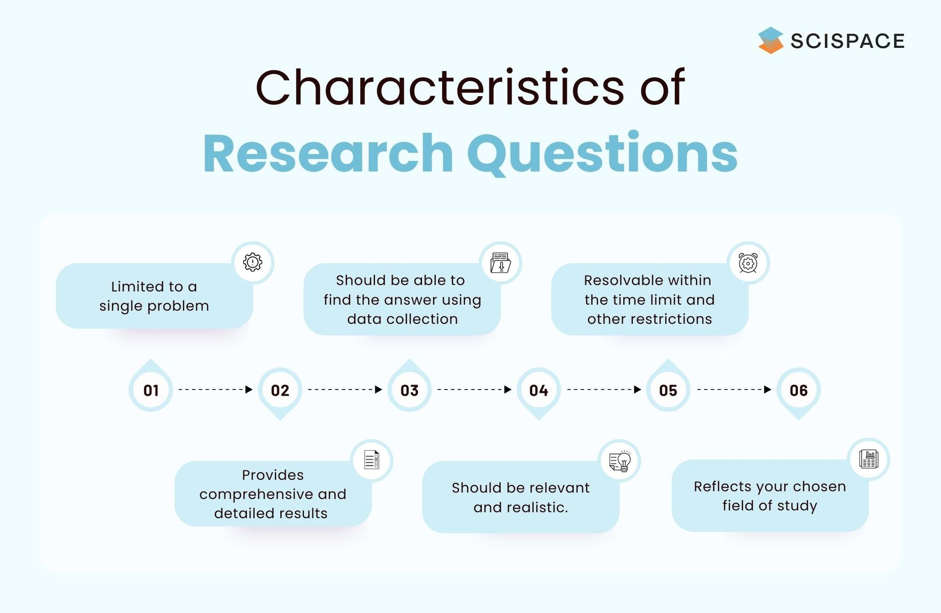
Academic writing and research require a distinct focus and direction. A well-designed research question gives purpose and clarity to your research. In addition, it helps your readers understand the issue you are trying to address and explore.
You must pose a question in order to effectively address a research problem.
A good research question must have the following characteristics.

Slide 3
Below is a list of common SAMPLE research questions that can be used in a dissertation.
Research Question Type | Question
Descriptive | What are the properties of A?
Comparative | What are the similarities and distinctions between A and B?
Correlational | What can you do to correlate variables A and B?
Exploratory | What factors affect the rate of C's growth? Are A and B also influencing C?
Explanatory | What are the causes for C? What does A do to B? What's causing D?
Evaluation | What is the impact of C? What role does B have? What are the benefits and drawbacks of A?
Action-Based | What can you do to improve X?

Slide 4
The following are a few examples of research questions and research problems to help you understand
how research questions can be created for a particular research problem.
Problem | Question
Due to poor revenue collection, a small-sized company ('A') in the UK cannot allocate a marketing budget next year. | What practical steps can the company take to increase its revenue?
Many graduates are now working as freelancers even though they have degrees from well-respected academic institutions. But what's the reason these young people choose to work in this field? | Why do fresh graduates choose to work for themselves rather than full-time? What are the benefits and drawbacks of the gig economy? What do age, gender, and academic qualifications do with people's perceptions of freelancing?

Slide 5
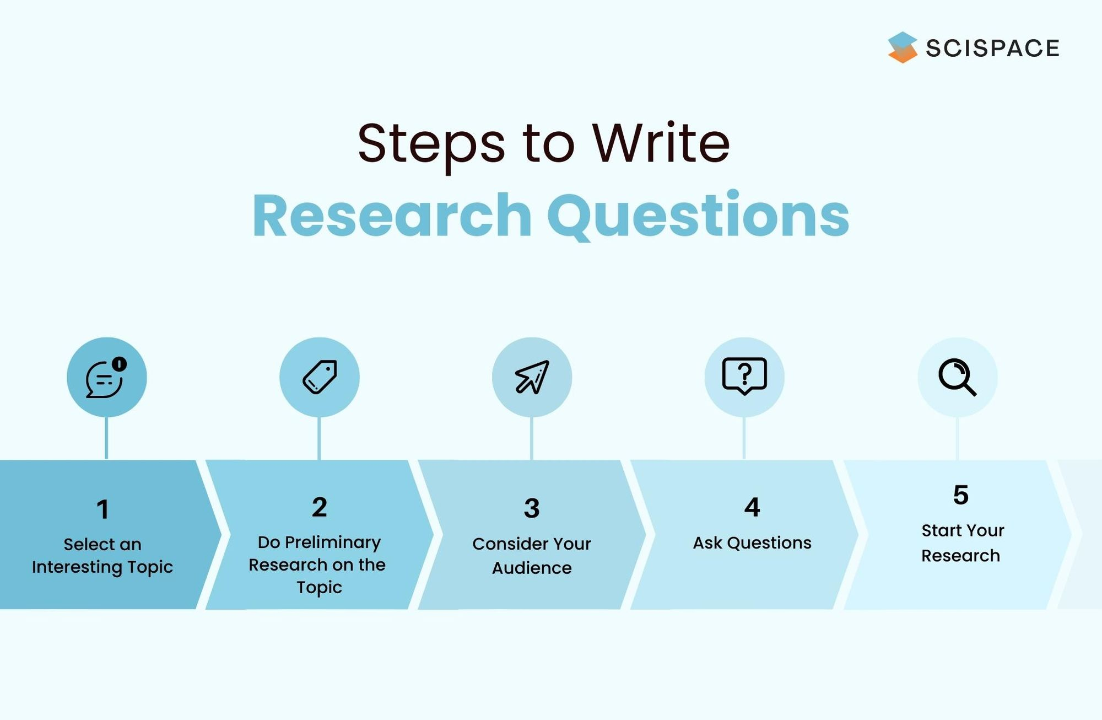

Slide 6
Strong Research Question Samples
Uncertain: How should social networking sites work on the hatred that flows through their platform?
Certain: What should social media sites like Twitter or Facebook do to address the harm they are causing?
Unfocused: What are the effects of global warming on the environment?
Focused: What are the most important effects of glacial melting in Antarctica on penguins' lives?
Too Simple: What are the U.S. doctors doing to treat diabetes?
Appropriately complex: Which factors, if any, are most likely to predict a person's risk of developing diabetes?

